Slide 1

Ahsanullah University of Science and Technology
Department of Electrical and Electronic Engineering
4th Year 2nd Semester
Course No : EEE-4234
Course Title : VLSI-II
Section : BCD
PROJECT PRESENTATION
PROJECT NAME : Full-chip design of a unidirectional USB transmitter using serial and parallel data communication modes. (USB controller)
GROUP_03
Submitted to- | Submitted by-
Partha Sanjoy Dev Part-time Teacher Department of Electrical and Electronic Engineering , AUST Mr. Md. Shanian Moed Lecturer Grade-II Department of Electrical and Electronic Engineering , AUST | Name | Student ID
 | Md. Mamunar Rahoman Roton | 20200105196 [TL]
 | Fahim Mahmud | 20200105212
 | Noor-E-Sadik Rupam | 20200105216
 | Humayra Tahassum | 20200105221
 | Saji Pal | 20200105235

Slide 2
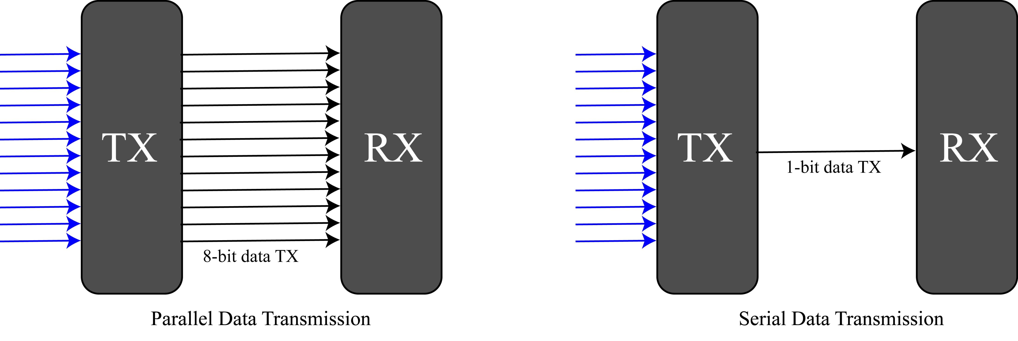

PROJECT NAME : Full-chip design of a unidirectional USB transmitter using serial and parallel data communication modes. (USB controller)
Serial & Parallel Data Communication -
I/O pin planning
INPUT | OUTPUT
mode
clk | 8-bit Coordinate out in parallel mode
rst | 4-bit Control out in parallel mode
4-bit move | 1-bit Coordinate out in serial mode
4-bit control | 1-bit Control out in serial mode
PROJECT THEME

Slide 3
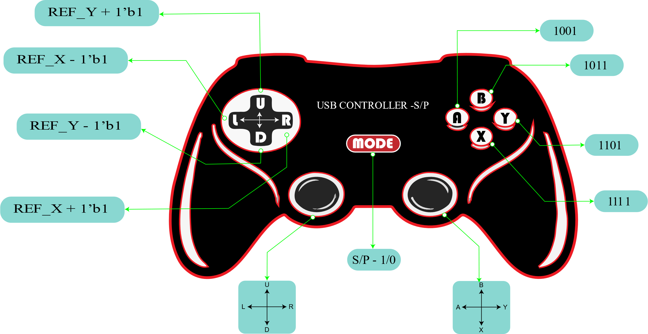
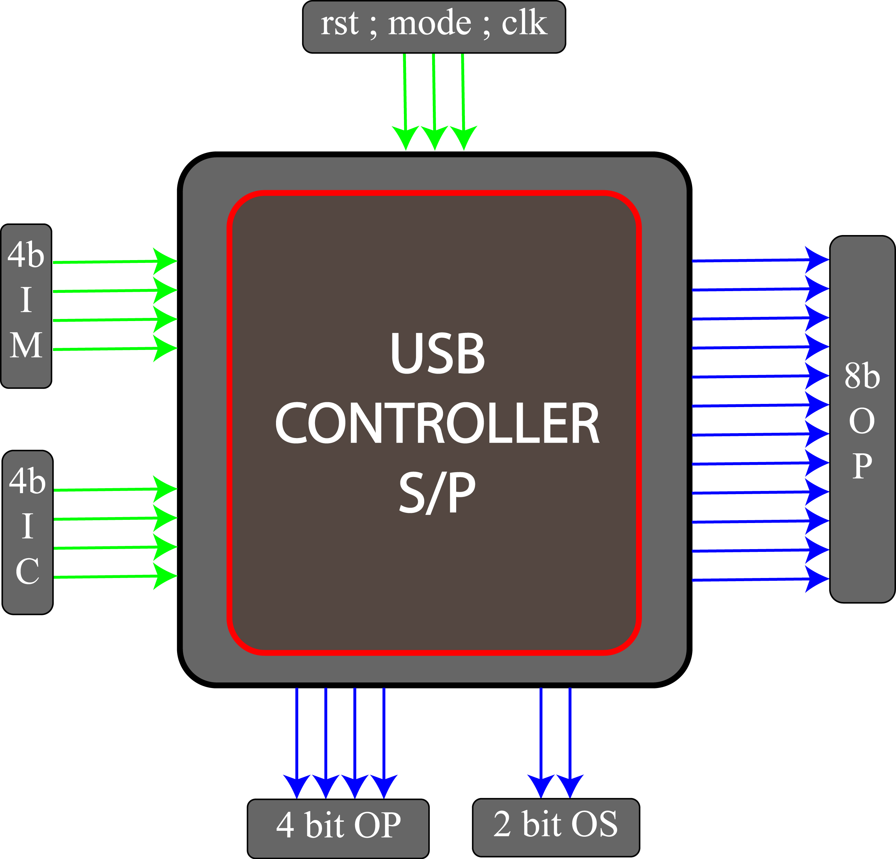
Practical Device to Chip mapping-
The above image is the representation of overall summary of the designed chip and chip’s pin arrangement.
This Chip is not multi task supported, it needs specific command to operate.

Slide 4
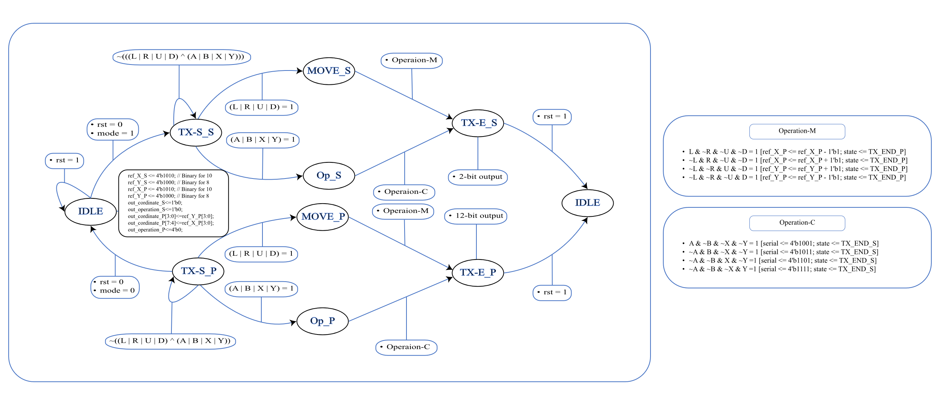
FSM diagram and design flow -

Slide 5
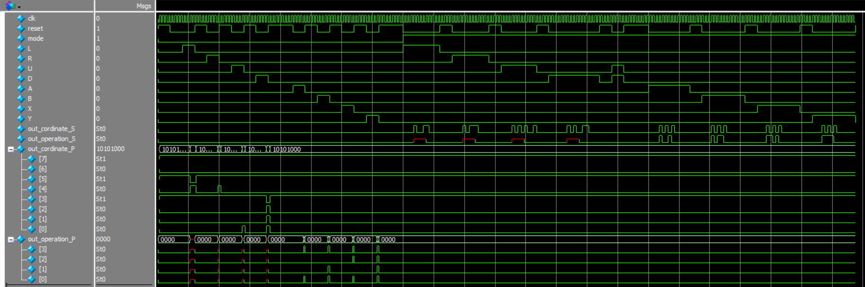
Verification Testbench – [ModelSim]
Output waveform or logic state | Generated from ModelSim using Verilog testbench code.

Slide 6
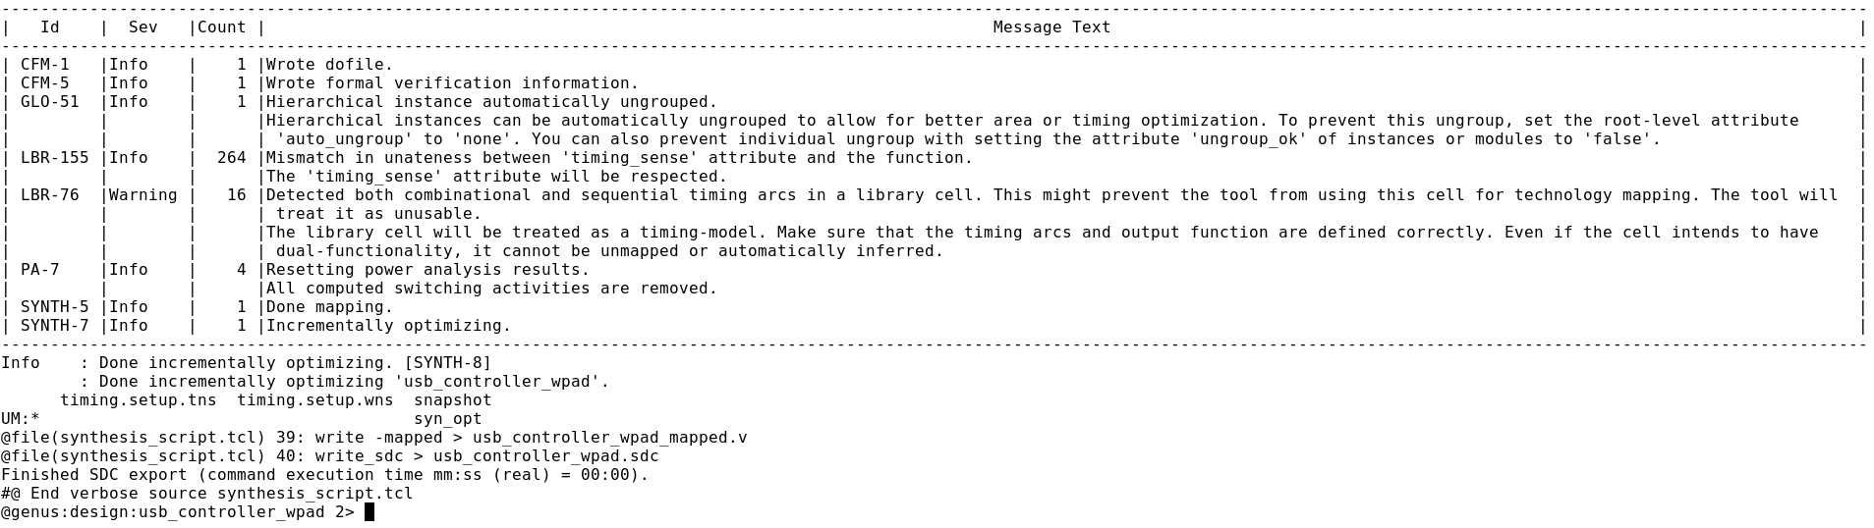
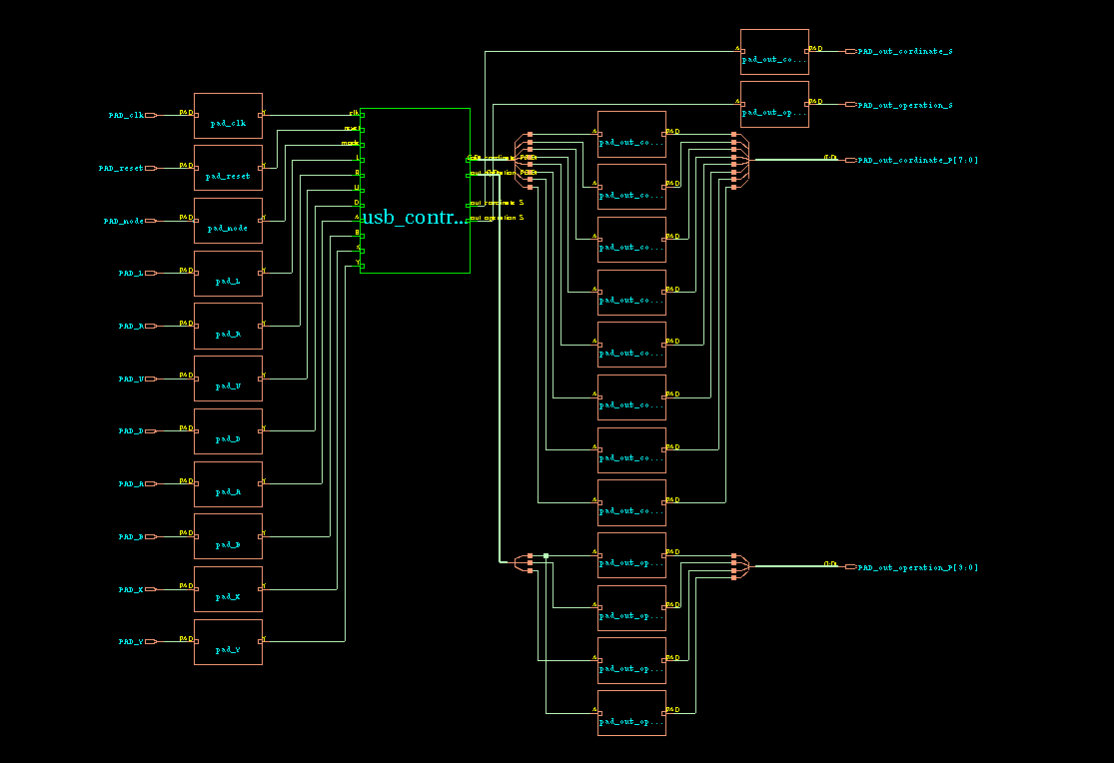
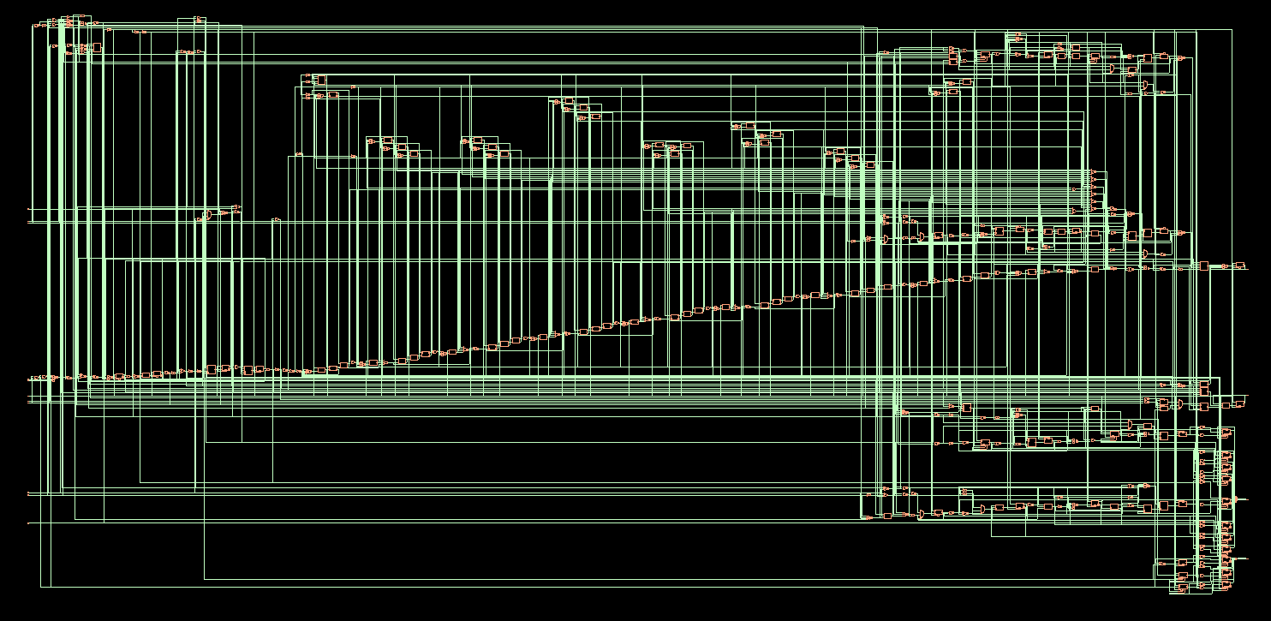
Full Chip with IO pad and full schematic diagram of usb controller | Generated from Cadence Genus synthesis Tool.
Full schematic diagram
Schematic diagram with IO pad.

Slide 7
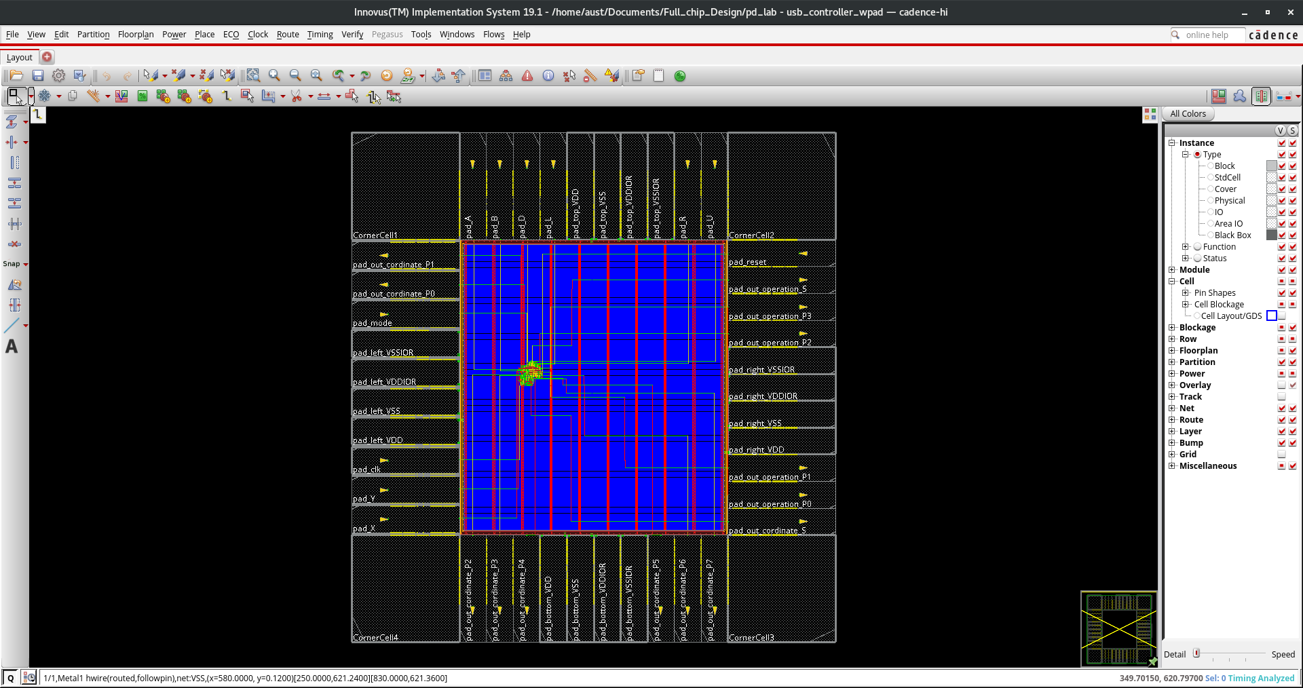
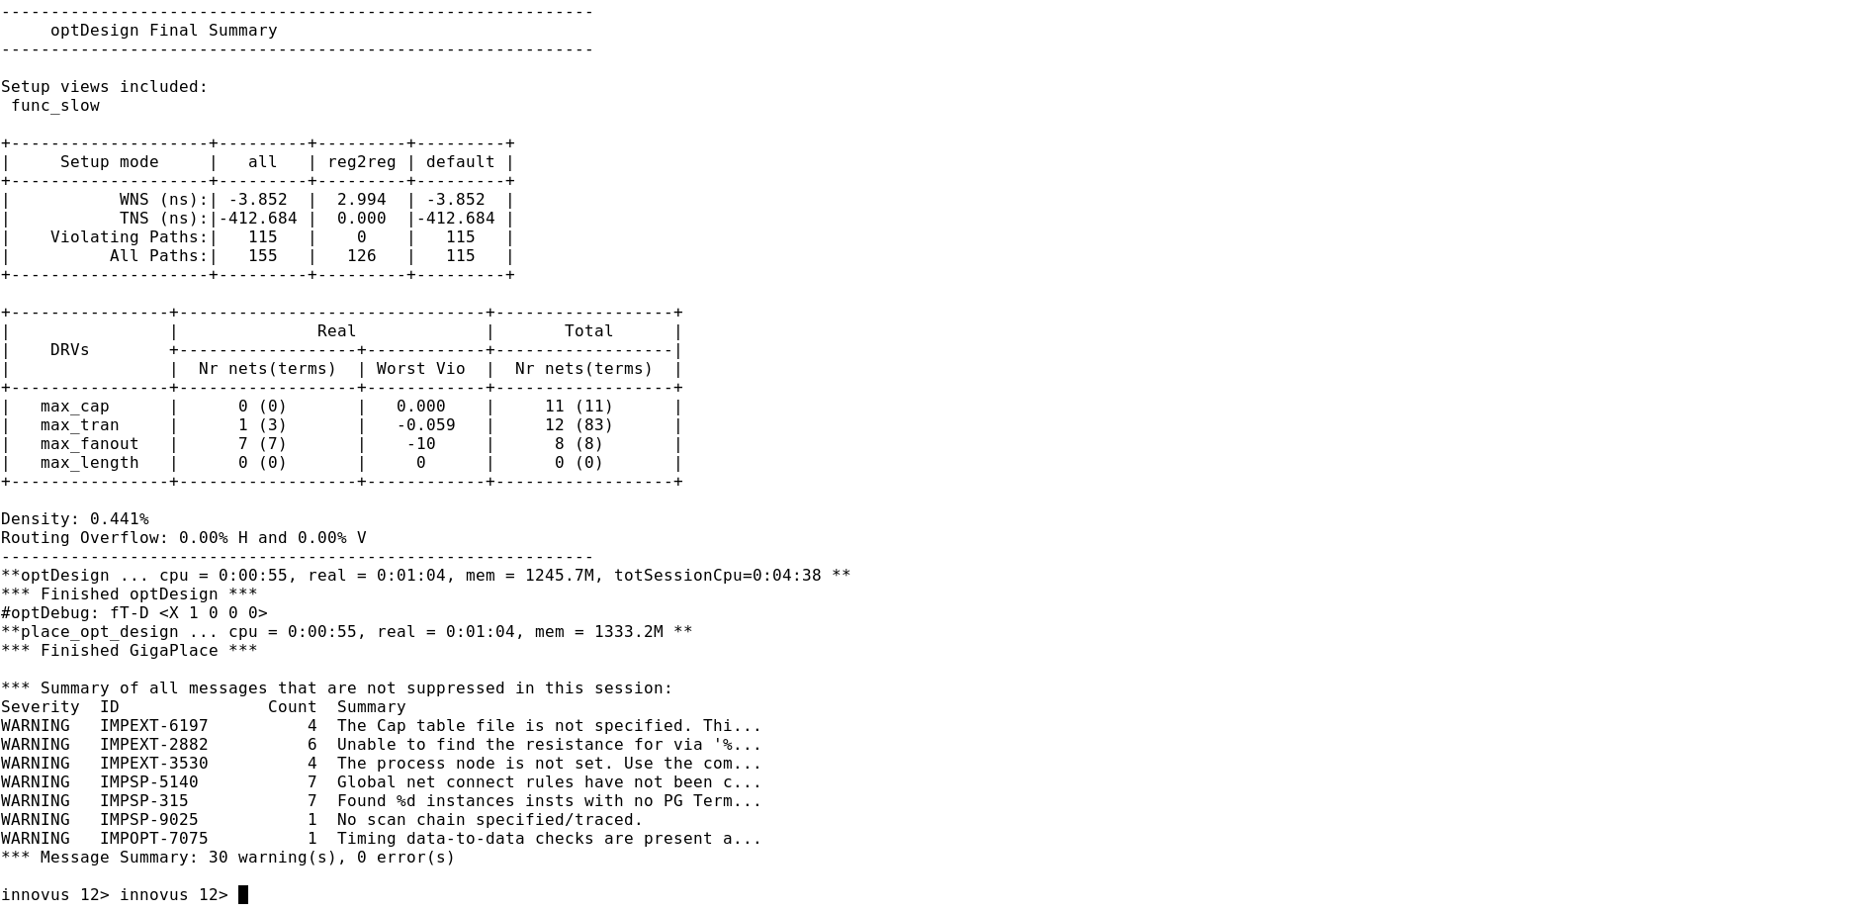
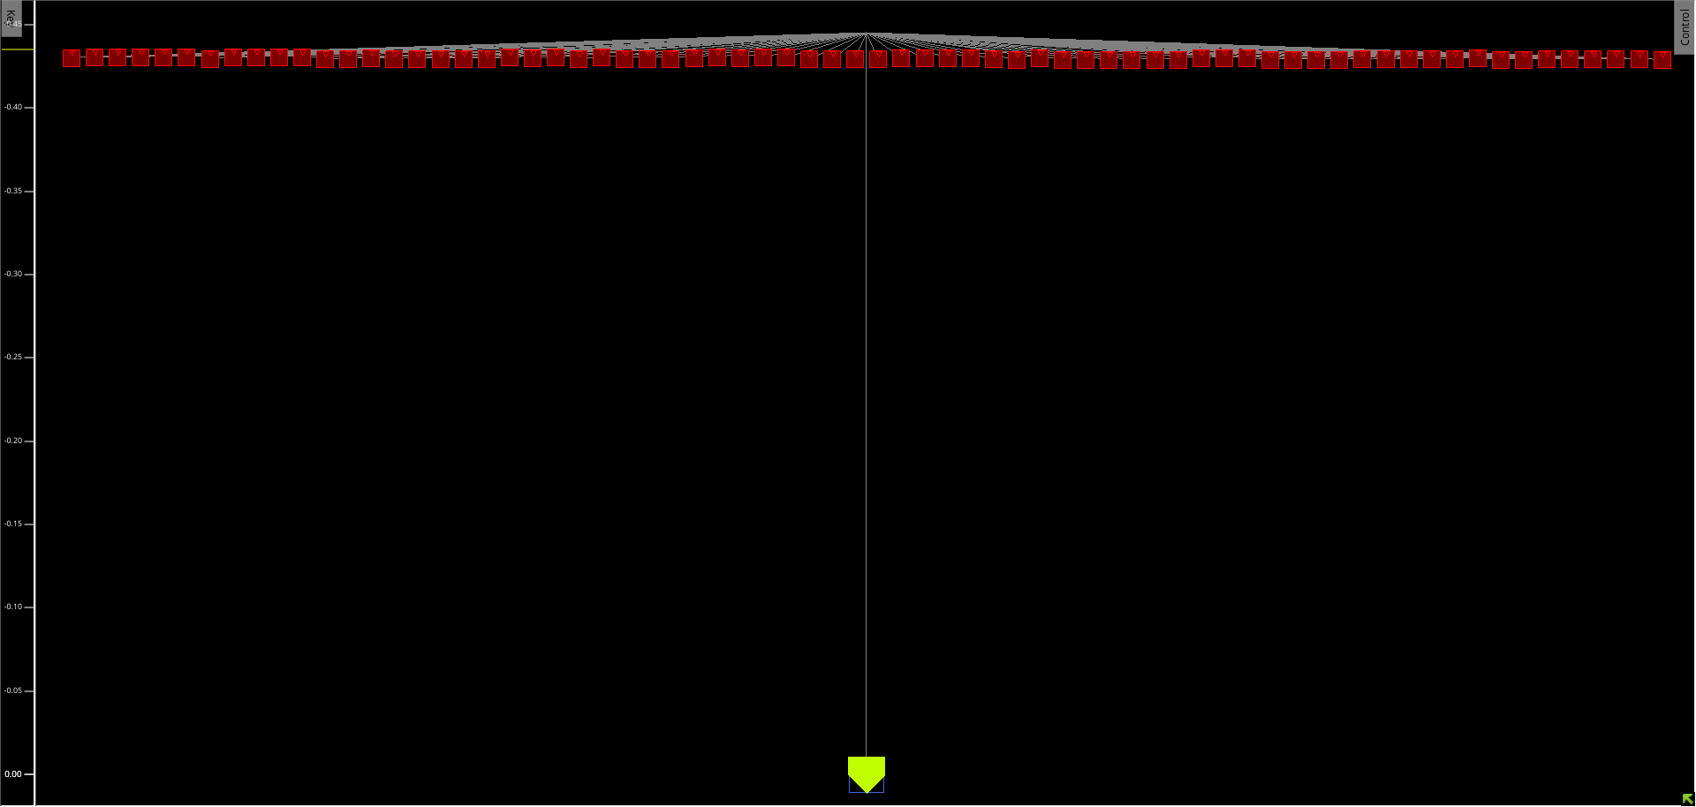
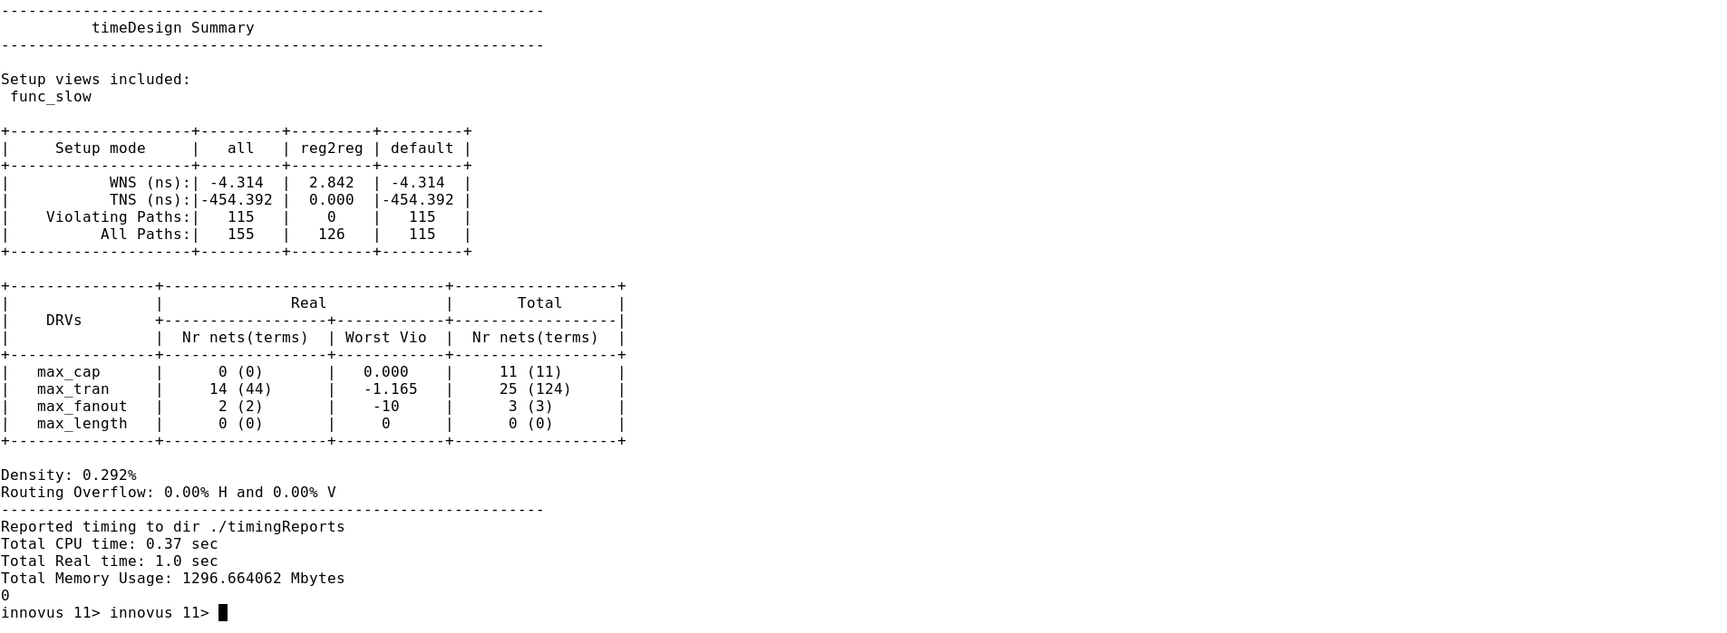
Design optimization and STA | Generated by Cadence Innovus PnR Tool.
Opt. Design
preCTS
Design
Placement
Pre-CTS
Clock Tree build and CTS Optimization

Slide 8
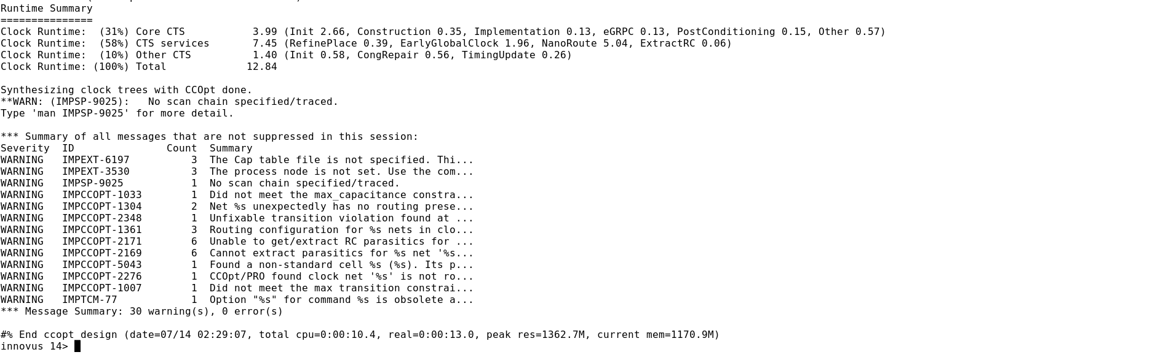
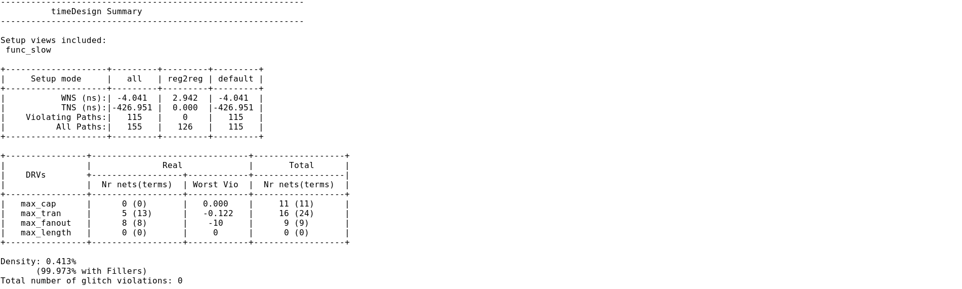
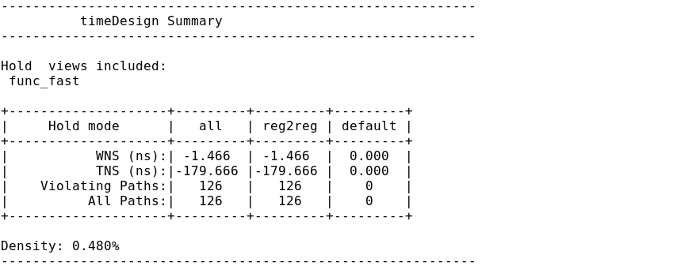
Design optimization and STA | Generated by Cadence Innovus PnR Tool.
Opt. Clock Tree. (CTS)
timeDesign
PostRoute
timeDesign
PostRoute -hold

Slide 9
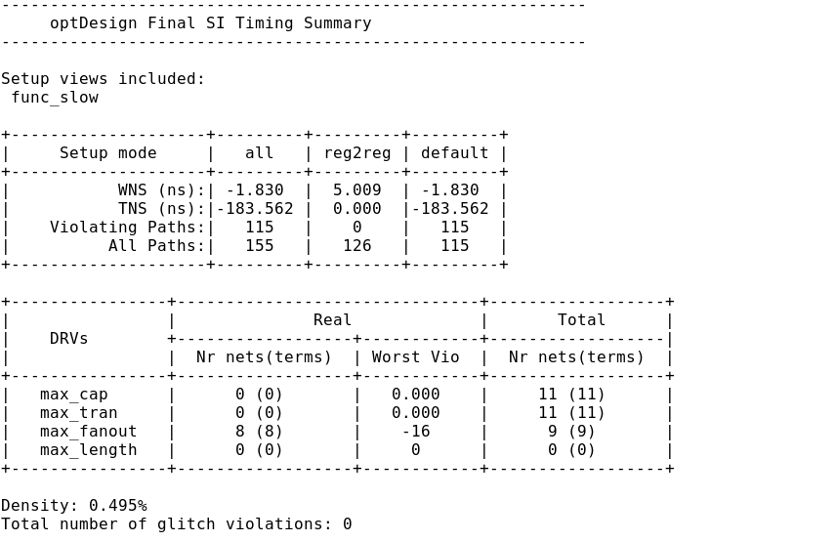
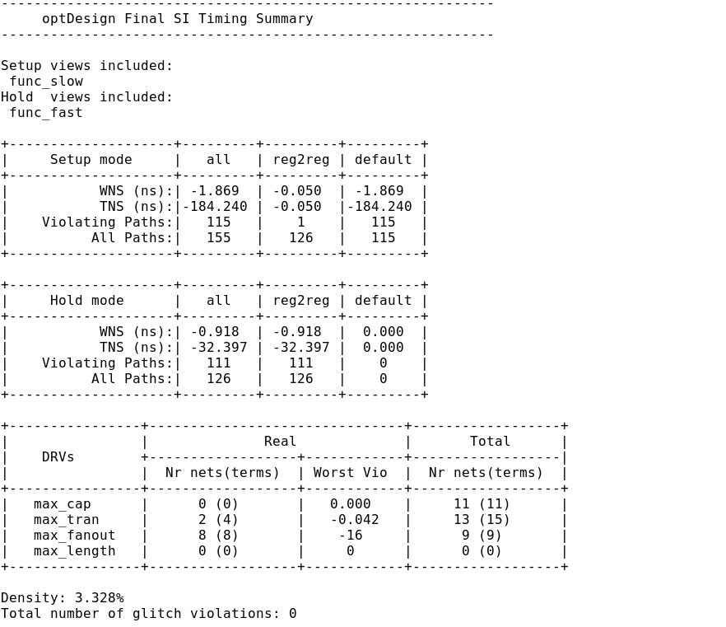
Design optimization and STA | Generated by Cadence Innovus PnR Tool.
Opt. Design
PostRoute
Opt. Design
PostRoute -hold

Slide 10
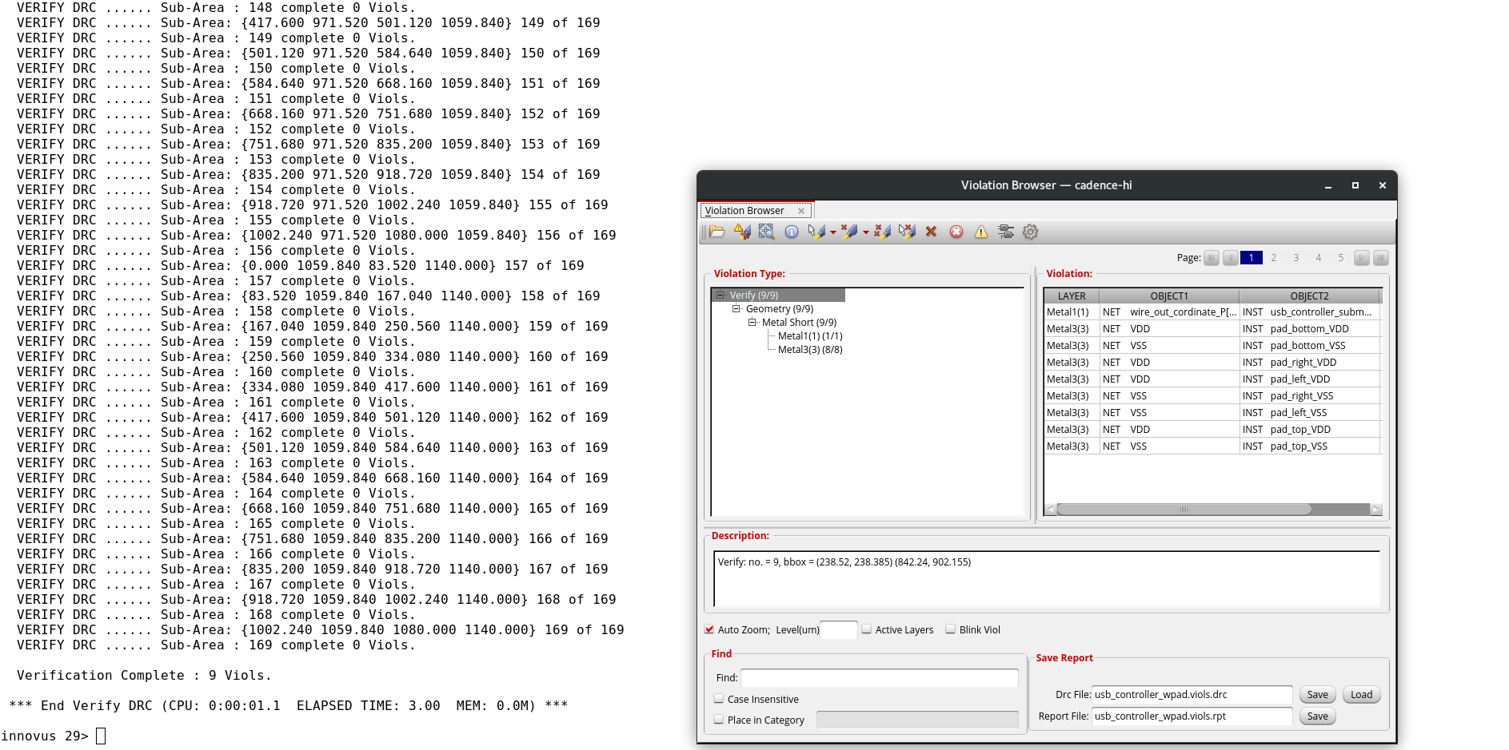
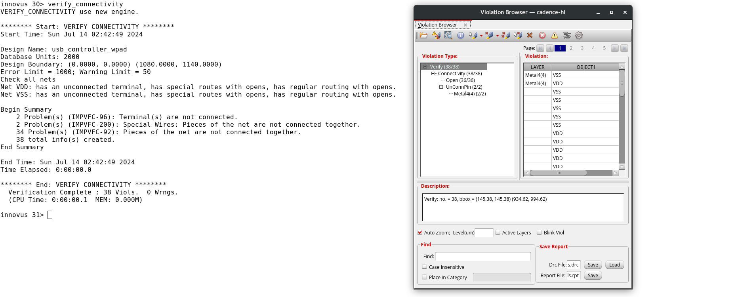
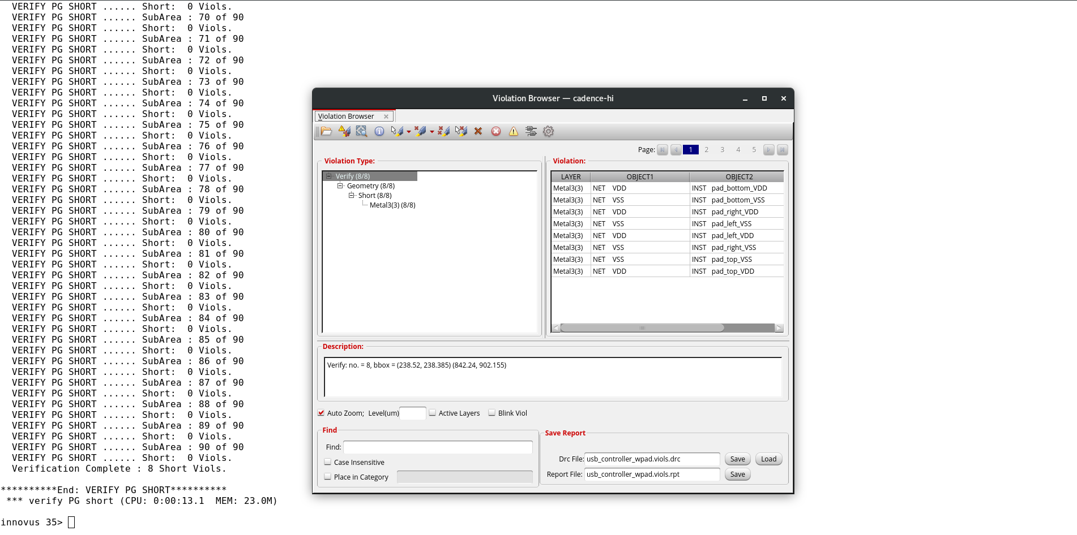
Physical Verification | Generated by Cadence Innovus PnR Tool.
DRC : 9 Viols
LVS : 38 Viols
PG_SHORT
8 Viols

Slide 11
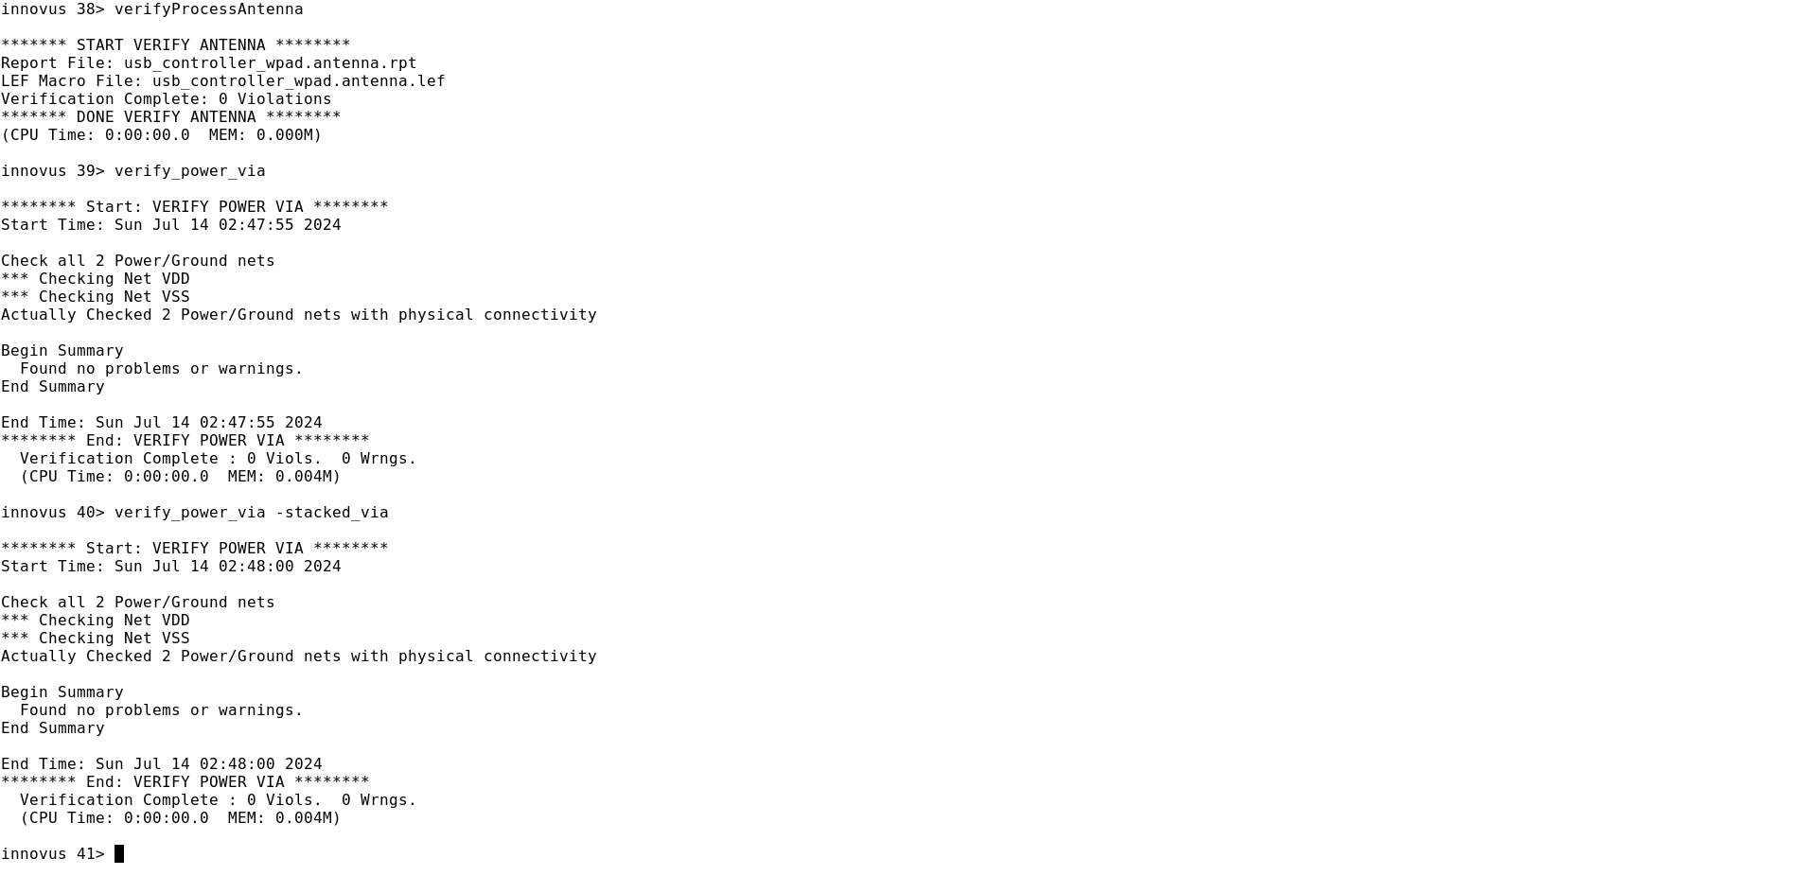
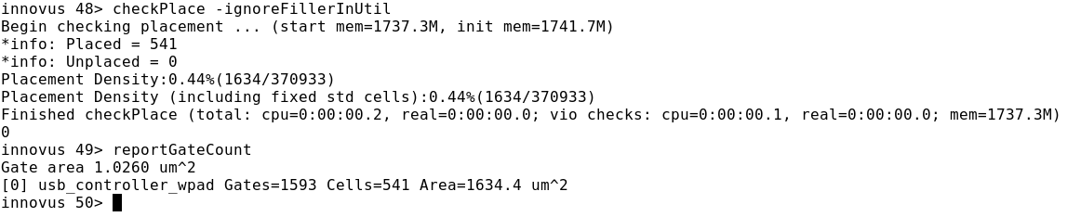
Physical Verification | Generated by Cadence Innovus PnR Tool.
Power via , Process Antenna verification
Placement Check and Gate Count
RESULT TABLE
Initial Clock Frequency (MHZ) | Max transition (ns) | Driving cell | Input Delay (ns) | Output Delay (ns) | Max Fanout | Total No. of cells | Total No. of gates | Gate Area (Um²) | No. Of DRC Viols. | No. Of LVS Viols. | No. Of ARC Viols. | No. Of PG short Viols.
205 | 0.9 | BUFX8 | 1.86 | 2.38 | 8 | 541 | 1593 | 1634.4 | 9 | 38 | 0 | 8

Slide 12
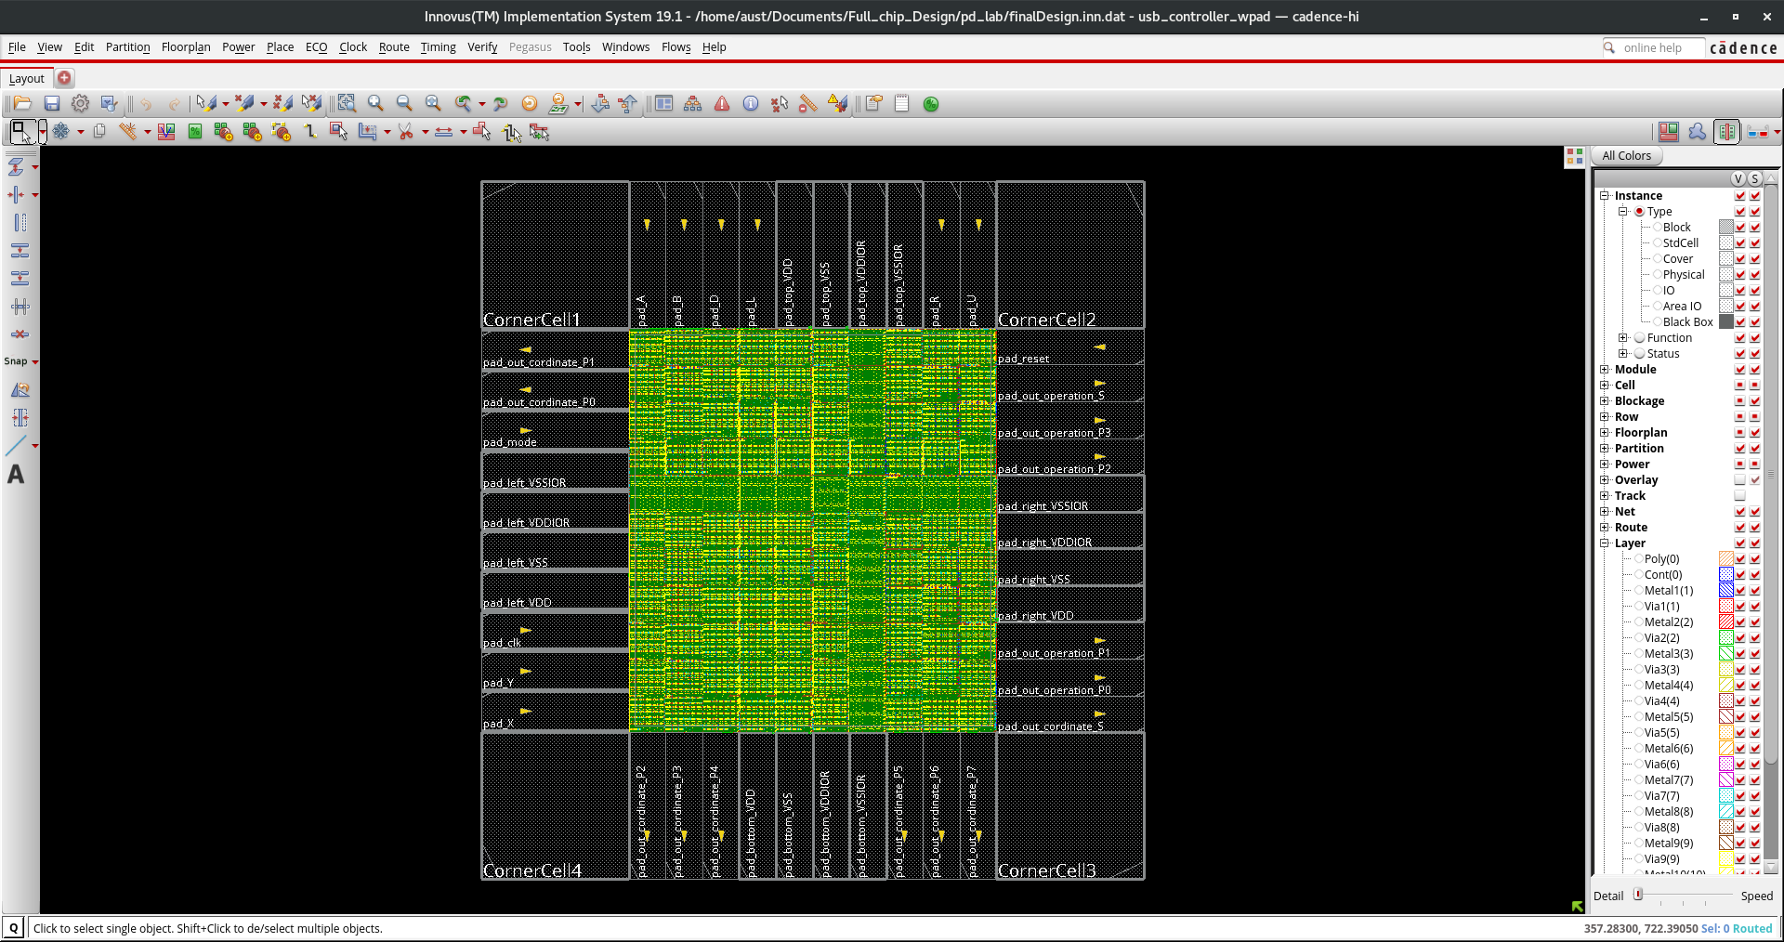
Final Design (Sign Off) | Generated by Cadence Innovus PnR Tool.

Slide 13
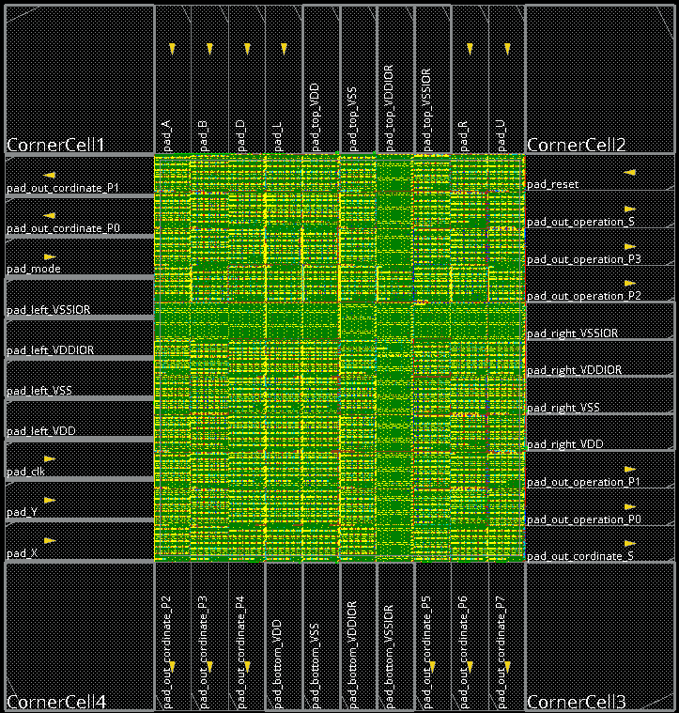
Question session!

